Slide 1
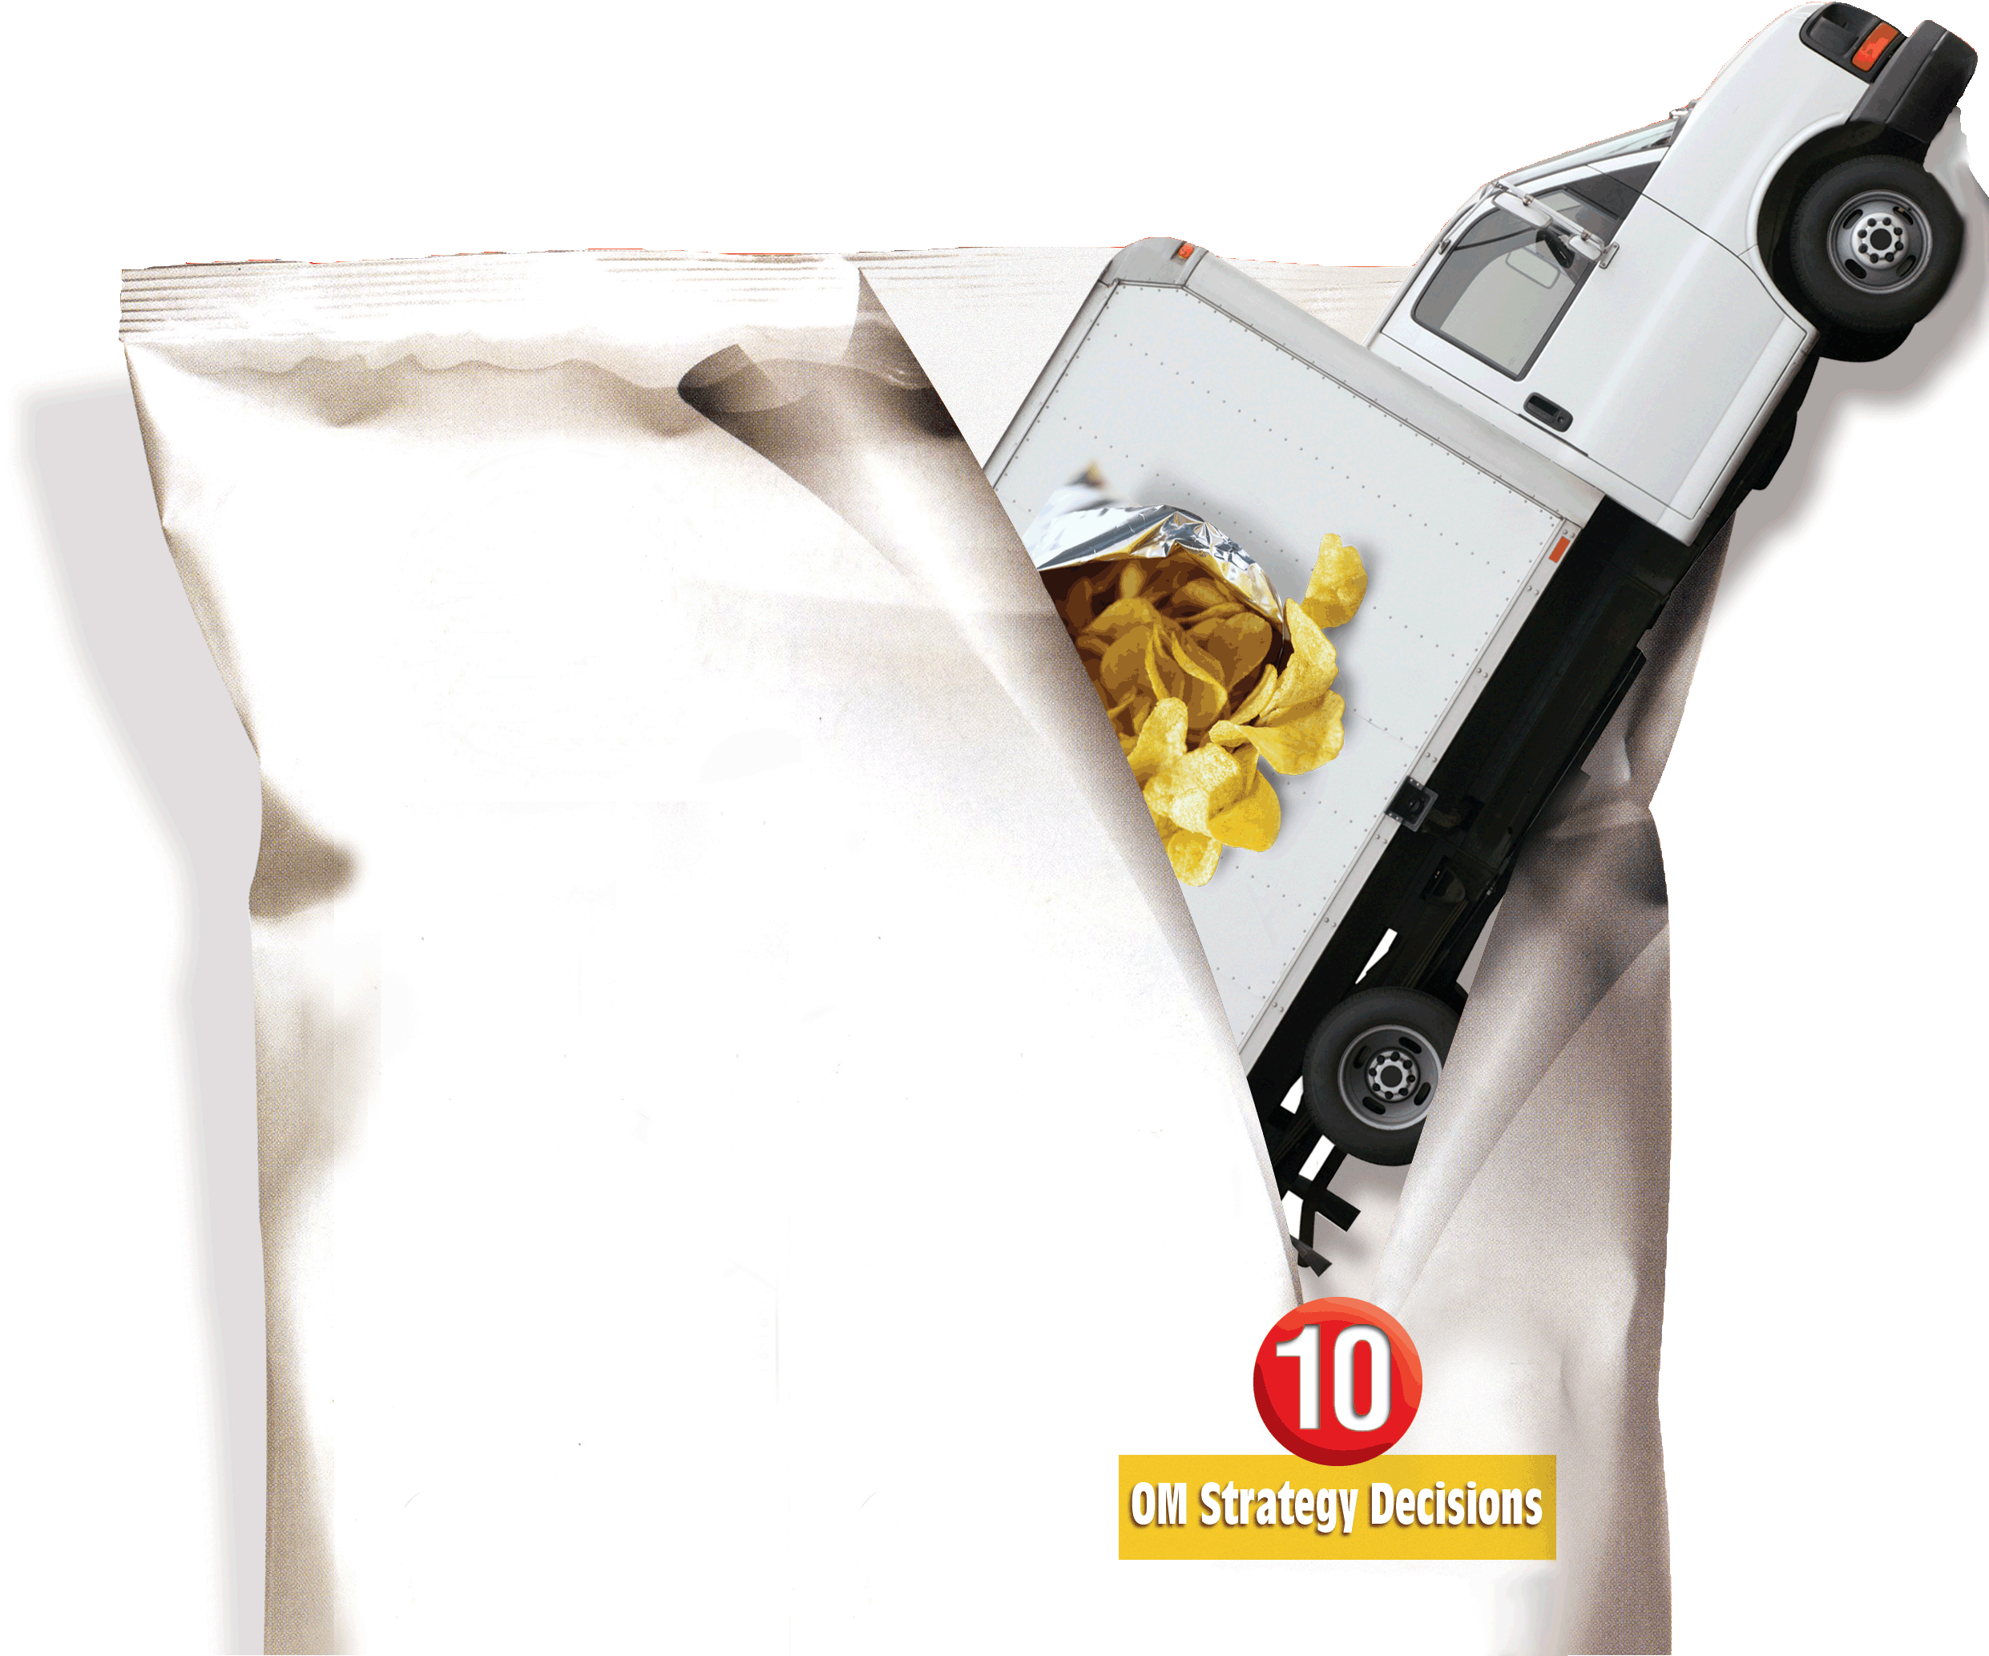
17
Maintenance and Reliability
PowerPoint presentation to accompany
Heizer and Render
Operations Management, 10e
Principles of Operations Management, 8e
PowerPoint slides by Jeff Heyl
Additional content from Gerry Cook

Slide 2
Outline
Global Company Profile: Orlando Utilities Commission
The Strategic Importance of Maintenance and Reliability
Reliability
  Improving Individual Components
  Providing Redundancy

Slide 3
Outline – Continued
Maintenance
  Implementing Preventive Maintenance
  Increasing Repair Capabilities
  Autonomous Maintenance
Total Productive Maintenance
Techniques for Enhancing Maintenance

Slide 4
Learning Objectives
When you complete this chapter you should be able to:
Describe how to improve system reliability
Determine system reliability
Determine mean time between failure (MTBF)

Slide 5
Learning Objectives
When you complete this chapter you should be able to:
Distinguish between preventive and breakdown maintenance
Describe how to improve maintenance
Compare preventive and breakdown maintenance costs
Define autonomous maintenance

Slide 6
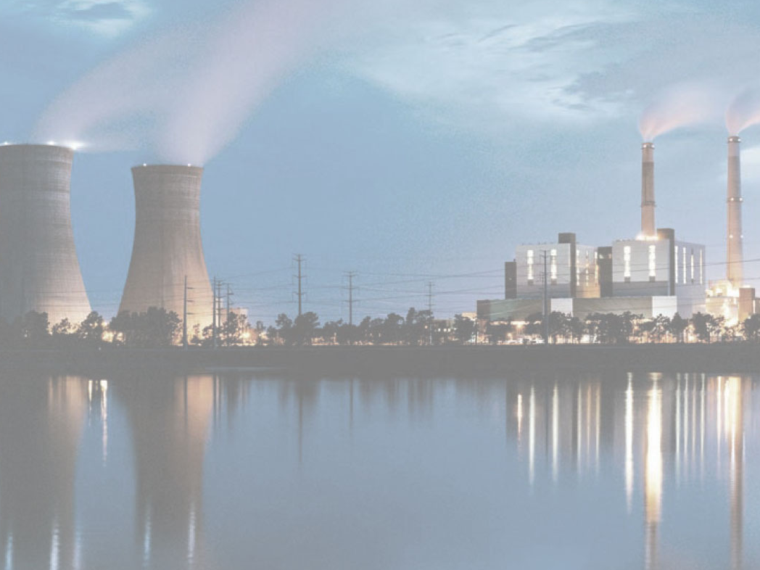
Orlando Utilities Commission
Maintenance of power generating plants
Every year each plant is taken off-line for 1-3 weeks maintenance
Every three years each plant is taken off-line for 6-8 weeks for complete overhaul and turbine inspection
Each overhaul has 1,800 tasks and requires 72,000 labor hours
OUC performs over 12,000 maintenance tasks each year

Slide 7
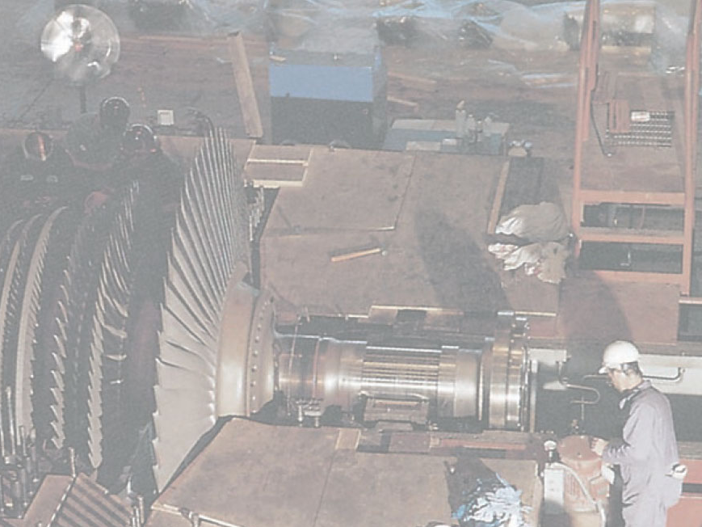
Orlando Utilities Commission
Every day a plant is down costs OUC $110,000
Unexpected outages cost between $350,000 and $600,000 per day
Preventive maintenance discovered a cracked rotor blade which could have destroyed a $27 million piece of equipment

Slide 8
Strategic Importance of Maintenance and Reliability
The objective of maintenance and reliability is to maintain the capability of the system

Slide 9
Strategic Importance of Maintenance and Reliability
Failure has far reaching effects on a firm’s
  Operation
  Reputation
  Profitability
  Dissatisfied customers
  Idle employees
  Profits becoming losses
  Reduced value of investment in plant and equipment

Slide 10
Maintenance and Reliability
Maintenance is all activities involved in keeping a system’s equipment in working order
Reliability is the probability that a machine will function properly for a specified time

Slide 11
Important Tactics
Reliability
  Improving individual components
  Providing redundancy
Maintenance
  Implementing or improving preventive maintenance
  Increasing repair capability or speed

Slide 12
Maintenance Management
Employee Involvement
Partnering with maintenance personnel
Skill training
Reward system
Employee empowerment
Results
Reduced inventory
Improved quality
Improved capacity
Reputation for quality
Continuous improvement
Reduced variability
Maintenance and Reliability Procedures
Clean and lubricate
Monitor and adjust
Make minor repair
Keep computerized records
Figure 17.1

Slide 13
Reliability
Improving individual components
R_{s} = R₁ x R₂ x R₃ x … x R_{n}
where R₁ = reliability of component 1
R₂ = reliability of component 2
and so on

Slide 14
Overall System Reliability
100 –
80 –
60 –
40 –
20 –
0 –
n = 1
n = 10
Reliability of the system (percent)
n = 50
n = 100
n = 200
n = 400
n = 300
| | | | | | | | |
100 99 98 97 96
Average reliability of each component (percent)
Figure 17.2

Slide 15
Reliability Example
R₁
R₂
R₃
.90
.80
.99
R_{s}
Reliability of the process is
R_{s} = R₁ x R₂ x R₃ = .90 x .80 x .99 = .713 or 71.3%

Slide 16
Product Failure Rate (FR)
Basic unit of measure for reliability
Number of failures
Number of units tested
FR(%) = x 100%
Number of failures
Number of unit-hours of operating time
FR(N) =
Mean time between failures
1
FR(N)
MTBF =

Slide 17
Failure Rate Example
20 air conditioning units designed for use in
NASA space shuttles operated for 1,000 hours
One failed after 200 hours and one after 600 hours
2
20
FR(%) = (100%) = 10%
2
20,000 - 1,200
FR(N) = = .000106 failure/unit hr
1
.000106
MTBF = = 9,434 hrs

Slide 18
Failure Rate Example
20 air conditioning units designed for use in
NASA space shuttles operated for 1,000 hours
One failed after 200 hours and one after 600 hours
Failure rate per trip
2
20
FR(%) = (100%) = 10%
FR = FR(N)(24 hrs)(6 days/trip)
FR = (.000106)(24)(6)
FR = .153 failures per trip
2
20,000 - 1,200
FR(N) = = .000106 failure/unit hr
1
.000106
MTBF = = 9,434 hrs

Slide 19
Providing Redundancy
Provide backup components to increase reliability
Probability of first component working
Probability of second component working
Probability of needing second component
+
x
(.8)
+
(.8)
x
(1 - .8)
= .8
+
.16 = .96

Slide 20
Redundancy Example
A redundant process is installed to support the earlier example where R_{s} = .713
R₁
R₂
R₃
Reliability has increased from .713 to .94
0.90
0.80
0.90
0.80
0.99
= [.9 + .9(1 - .9)] x [.8 + .8(1 - .8)] x .99
= [.9 + (.9)(.1)] x [.8 + (.8)(.2)] x .99
= .99 x .96 x .99 = .94

Slide 21
Maintenance
Two types of maintenance
  Preventive maintenance – routine inspection and servicing to keep facilities in good repair
  Breakdown maintenance – emergency or priority repairs on failed equipment

Slide 22
Implementing Preventive Maintenance
Need to know when a system requires service or is likely to fail
High initial failure rates are known as infant mortality
Once a product settles in, MTBF generally follows a normal distribution
Good reporting and record keeping can aid the decision on when preventive maintenance should be performed

Slide 23
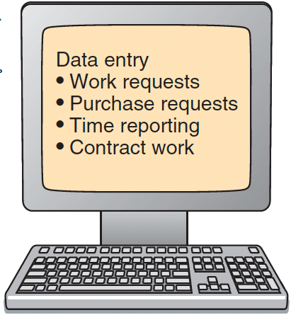
Computerized Maintenance System
Data Files
Output Reports
Equipment file with parts list
Inventory and purchasing reports
Maintenance
and work order schedule
Equipment parts list
Repair history file
Equipment history reports
Cost analysis
(Actual vs. standard)
Inventory of spare parts
Work orders
Preventive maintenance
Scheduled downtime
Emergency maintenance
Personnel data with skills, wages, etc.
Figure 17.3

Slide 24
Maintenance Costs
The traditional view attempted to balance preventive and breakdown maintenance costs
Typically this approach failed to consider the true total cost of breakdowns
  Inventory
  Employee morale
  Schedule unreliability

Slide 25
Maintenance Costs
Total costs
Preventive maintenance costs
Costs
Breakdown maintenance costs
Maintenance commitment
Optimal point (lowest
cost maintenance policy)
Traditional View
Figure 17.4 (a)

Slide 26
Maintenance Costs
Total costs
Full cost of breakdowns
Costs
Preventive maintenance costs
Maintenance commitment
Optimal point (lowest
cost maintenance policy)
Full Cost View
Figure 17.4 (b)

Slide 27
Maintenance Cost Example
Should the firm contract for maintenance on their printers?
Number of Breakdowns | Number of Months That Breakdowns Occurred
0 |  | 2
1 |  | 8
2 |  | 6
3 |  | 4
 | Total : | 20
Average cost of breakdown = $300

Slide 28
Maintenance Cost Example
Compute the expected number of breakdowns
Number of Breakdowns | Frequency | Number of Breakdowns | Frequency
0 | 2/20 = .1 | 2 | 6/20 = .3
1 | 8/20 = .4 | 3 | 4/20 = .2
Expected number of breakdowns
∑
Number of breakdowns
Corresponding frequency
=
x
= (0)(.1) + (1)(.4) + (2)(.3) + (3)(.2)
= 1.6 breakdowns per month

Slide 29
Maintenance Cost Example
Compute the expected breakdown cost per month with no preventive maintenance
Expected breakdown cost
=
Expected number of breakdowns
x
Cost per breakdown
= (1.6)($300)
= $480 per month

Slide 30
Maintenance Cost Example
Compute the cost of preventive maintenance
Preventive maintenance cost
Cost of expected breakdowns if service contract signed
Cost of
service contract
=
+
= (1 breakdown/month)($300) + $150/month
= $450 per month
Hire the service firm; it is less expensive

Slide 31
Increasing Repair Capabilities
Well-trained personnel
Adequate resources
Ability to establish repair plan and priorities
Ability and authority to do material planning
Ability to identify the cause of breakdowns
Ability to design ways to extend MTBF

Slide 32
How Maintenance is Performed
Operator
(autonomous maintenance)
Maintenance department
Manufacturer’s field service
Depot service
(return equipment)
Competence is higher as we
move to the right
Preventive
maintenance costs less and
is faster the more we move to the left
Increasing Operator Ownership
Increasing Complexity
Figure 17.5

Slide 33
Autonomous Maintenance
Employees accept responsibility for
  Observe
  Check
  Adjust
  Clean
  Notify
Predict failures, prevent breakdowns, prolong equipment life

Slide 34
Total Productive Maintenance (TPM)
Designing machines that are reliable, easy to operate, and easy to maintain
Emphasizing total cost of ownership when purchasing machines, so that service and maintenance are included in the cost

Slide 35
Total Productive Maintenance (TPM)
Developing preventive maintenance plans that utilize the best practices of operators, maintenance departments, and depot service
Training for autonomous maintenance so operators maintain their own machines and partner with maintenance personnel

Slide 36
Techniques for Enhancing Maintenance
Simulation
  Computer analysis of complex situations
  Model maintenance programs before they are implemented
  Physical models can also be used

Slide 37
Techniques for Enhancing Maintenance
Expert systems
  Computers help users identify problems and select course of action
Automated sensors
  Warn when production machinery is about to fail or is becoming damaged
  The goals are to avoid failures and perform preventive maintenance before machines are damaged

Slide 38
More on Maintenance –
Supplemental Material
A simple redundancy formula
Problems with breakdown and preventive maintenance
Predictive maintenance
Predictive maintenance tools
Maintenance strategy implementation
Effective reliability

Slide 39
Providing Redundancy –
An Alternate Formula
The reliability of one pump =
The probability of one pump not failing = 0.8
P(failing) = 1- P(not failing) = 1 - 0.8 = .2
If there are two pumps with the same probability of not failing
P(failure of both pumps) =
P(failure) pump #1 x P(failure) pump #2
P(failure of both pumps) = 0.2 x 0.2 = .04
P(at least one pump working) =
1.0 - .04 = .96

Slide 40
Problems With Breakdown Maintenance
“Run it till it breaks”
  Might be ok for low criticality equipment or redundant systems
  Could be disastrous for mission-critical plant machinery or equipment
  Not permissible for systems that could imperil life or limb (like aircraft)

Slide 41
Problems With Preventive Maintenance
“Fix it whether or not it is broken”
  Scheduled replacement or adjustment of parts/equipment with a well-established service life
  Typical example – plant relamping
  Sometimes misapplied
    Replacing old but still good bearings
    Over-tightening electrical lugs in switchgear

Slide 42
Another Maintenance Strategy
Predictive maintenance – Using advanced technology to monitor equipment and predict failures
  Using technology to detect and predict imminent equipment failure
  Visual inspection and/or scheduled measurements of vibration, temperature, oil and water quality
  Measurements are compared to a “healthy” baseline
  Equipment that is trending towards failure can be scheduled for repair

Slide 43
Predictive Maintenance Tools
Vibration analysis
Infrared Thermography
Oil and Water Analysis
Other Tools:
  Ultrasonic testing
  Liquid Penetrant Dye testing
  Shock Pulse Measurement (SPM)

Slide 44
Predictive Maintenance Vibration Analysis
Using sensitive transducers and instruments to detect and analyze vibration
Typically used on expensive, mission-critical equipment–large turbines, motors, engines or gearboxes
Sophisticated frequency (FFT) analysis can pinpoint the exact moving part that is worn or defective
Can utilize a monitoring service

Slide 45
Predictive Maintenance Infrared (IR) Thermography
Using IR cameras to look for temperature “hot spots” on equipment
Typically used to check electrical equipment for wiring problems or poor/loose connections
Can also be used to look for “cold (wet) spots” when inspecting roofs for leaks
High quality IR cameras are expensive – most pay for IR thermography services

Slide 46
Predictive Maintenance
Oil and Water Analysis
Taking oil samples from large gearboxes, compressors or turbines for chemical and particle analysis
  Particle size can indicate abnormal wear
Taking cooling water samples for analysis – can detect excessive rust, acidity, or microbiological fouling
Services usually provided by oil vendors and water treatment companies

Slide 47
Predictive Maintenance
Other Tools and Techniques
Ultrasonic and dye testing – used to find stress cracks in tubes, turbine blades and load bearing structures
  Ultrasonic waves sent through metal
  Surface coated with red dye, then cleaned off, dye shows cracks
Shock-pulse testing – a specialized form of vibration analysis used to detect flaws in ball or roller bearings at high frequency (32kHz)

Slide 48
Maintenance Strategy Comparison
Maintenance Strategy | Advantages | Disadvantages | Resources/ Technology Required | Application Example
Breakdown | No prior work required | Disruption of production, injury or death | May need labor/parts at odd hours | Office copier
Preventive | Work can be scheduled | Labor cost, may replace healthy components | Need to obtain labor/parts for repairs | Plant relamping, Machine lubrication
Predictive | Impending failures can be detected & work scheduled | Labor costs, costs for detection equipment and services | Vibration, IR analysis equipment or purchased services | Vibration and oil analysis of a large gearbox

Slide 49
Maintenance Strategy Implementation
Percentage of Maintenance Time by Strategy
100%
80%
60%
40%
20%
0%
Predictive
Preventive
Breakdown
1 2 3 4 5 6 7 8 9 10
Year

Slide 50
Is Predictive Maintenance
Cost Effective?
In most industries the average rate of return is 7:1 to 35:1 for each predictive maintenance dollar spent
Vibration analysis, IR thermography and oil/water analysis are all economically proven technologies
The real savings is the avoidance of manufacturing downtime – especially crucial in JIT

Slide 51
Predictive Maintenance and Effective Reliability
Effective Reliability (R_{eff}) is an extension of Reliability that includes the probability of failure times the probability of not detecting imminent failure
Having the ability to detect imminent failures allows us to plan maintenance for the component in failure mode, thus avoiding the cost of an unplanned breakdown
R_{eff} = 1 – (P(failure) x P(not detecting failure))

Slide 52
How Predictive Maintenance Improves Effective Reliability
Example: a large gearbox with a reliability of .90 has vibration transducers installed for vibration monitoring. The probability of early detection of a failure is .70. What is the effective reliability of the gearbox?
R_{eff} = 1 – (P(failure) x P(not detecting failure))
R_{eff} = 1 – (.10 x .30) = 1 - .03 = .97
Vibration monitoring has increased the effective reliability from .90 to .97!

Slide 53
Effective Reliability Caveats
Predictive maintenance only increases effective reliability if:
  You select the method that can detect the most likely failure mode
  You monitor frequently enough to have high likelihood of detecting a change in component behavior before failure
  Timely action is taken to fix the issue and forestall the failure (in other words you don’t ignore the warning!)

Slide 54
Increasing Repair Capabilities
Well-trained personnel
Adequate resources
Proper application of the three maintenance strategies
Continual improvement to improve equipment/system reliability

Slide 55

All rights reserved. No part of this publication may be reproduced, stored in a retrieval system, or transmitted, in any form or by any means, electronic, mechanical, photocopying, recording, or otherwise, without the prior written permission of the publisher.
Printed in the United States of America.

